Slide 1

Accelerate application delivery with a Cloud-native mindset
Andrew Hately
Vice President, Chief Architect
IBM Watson and Cloud

Slide 2
Adopt
Refactor
Plan
Scale
Migrate
Extend
Notes:
All starting from different places… Cloud Native is the destination – but what are the steps on the journey and
The combination of DevOps and a need to have continuous delivery along with the maturity of our tools to enable us to do that are prerequisites for being successful. And cloud as a platform for hosting and running them gives us the ability to represent everything as code and being able to go end to end all the way to the lifecycle – from development through production in an automated way and of course gives us the scale and flexibility that we need to take service based apps and run them globally at scale and increase them as we need to.
So rise of cloud and DevOps together set the stage to enable microservices to be a practical approach for teams who are building applications.

Slide 3





530+
/
DAY
MILLION
Personal Weather
Station reports
over 9
/
DAY
MILLION
webcam uploads
400TB
of new data
over 2
/
MONTH
EVERY
MILLION
CROWD REPORTS
DAY
40+
/
DAY
MILLION
IoT Barometric
Pressure Reports
Notes:
Scale is the destination – and that takes two forms – as we think of it traditionally – massive data, the API millionaire and billionaire club backed by data lakes and massively horizontal scaled Web Applications

Slide 4
Notes:
Perhaps the bigger driver is the shift to more intuitive systems.. The heavy computing lifting behind digital transformation and more conversational applications.

Slide 5
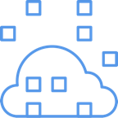


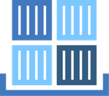

Bare Metal
Virtual Server or VMware
Containers
Runtimes or Cloud Foundry
Functions
Notes:
Workloads should be placed where they are most appropriate and integrated – and where they are most optimized…
To the right is simplicity of development and simplicity of scaling… to the left is simplicity of migration and often, operating system level optimization and tuning.
To the right is opinionated platforms, constraints – and that gets you speed to adapt, speed to scale, and that is what we’re talking about with Cloud Native

Slide 6
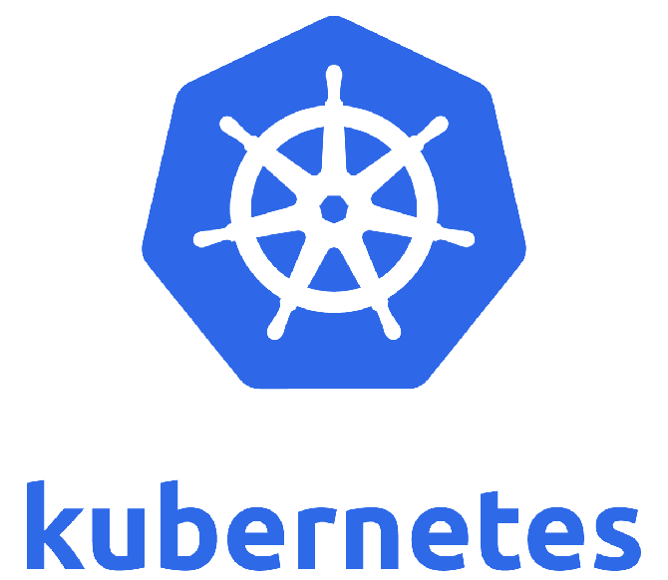
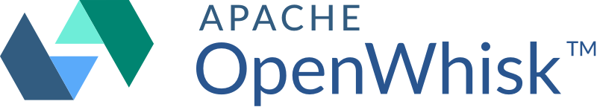

Notes:
It is that very opinion built into the framework that sets you on the Cloud native journey – one where you focus on the code and the integration points, and less on optimizing the plumbing.
Now, when it comes to implementing a microservice you lots of choices from the programming language used to the runtime options. Any programming language can be used – Java, python, ruby, javascript with nodejs, scala, swift, and go are all popular options. In theory, every microservice can be implemented in a different programming language. This may not be a good idea based on your staffing and their skills but it is common for multiple programming languages to be used in cloud applications.
For runtimes, you likewise have choices depending on how much control over the environment you need and on the charactertic of the service itself.
At the “ease of getting started” side we have serverless, event-driven environments like Open Whisk. These are suitable for data transformations triggered by events, time based transactions like aggregating data from multiple sources on a daily or periodic basis, and so-called “stored procedure as a service” type access to an underlying data store.
Serverless environments like Open Whisk provide “functions as a service” and completely remove any need to control or specify the runtime environment other than the programming language and way events are triggered.
You could model a microservice as a application using a PaaS like Cloud Foundry. This gives you some control of the runtime size and capabilities and lets the microservice be ”always on” and not have the startup costs of typical serverless Functions as a Service.
Containers provide a portable and consistent delivery mechanism for a microservice without having to manage all the underlying OS details. Technologies like Docker and Kubernetes provide mechanisms for isolation, location independence, scalability, and resilience for microservices giving you more control over the OS environment the service is running in.
Finally, VMs and bare metal services give you near complete control of the environment and the most flexibility to scale the performance of the service.

Slide 7


